Slide 1
Applied Programming & Design Principles
S - 03
Ms. ALF. Sajeetha
Lecturer - IT

Slide 2
Object-oriented programming (OOP) in Python follows the four fundamental principles known as the "Four Pillars of OOP
Abstraction
It involves hiding the complex implementation details and showing only the relevant functionalities of an object.
2. Encapsulation
Bundling of data (attributes) and the methods (functions) that operate on the data into a single unit called a class
3. Inheritance
Ability of a class to inherit properties and behaviors from another class, allowing for code reuse and creating a hierarchy of classes.
4. Polymorphism
It allows objects of different types to be treated as objects of a common type. It enables a single interface to represent different types of objects

Slide 3
Abstraction

Slide 4
Abstraction
An abstraction is a view or representation of an entity that includes only the most significant attributes and processes (methods).
Abstraction is a weapon against the complexity of programming; its purpose is to simplify the programming process.
Abstraction is an effective weapon because it allows programmers to focus on essential attributes while ignoring subordinate attributes.
Abstraction allows one to collect instances of entities into groups in which their common attributes need not be considered.
E.g.: Suppose we define birds to be creatures with the following attributes: two wings, two legs, a tail, and feathers. Then, if we say a crow is a bird, a description of a crow need not include those attributes.

Slide 5
Data Abstraction
The common attributes in the descriptions of specific species of birds can be abstracted away because all species have them.
Within a particular species, only the attributes that distinguish that species need to be considered.
E.g.: Crows have the attributes of being black (Colour), being of a particular size (Size), and being noisy (Sound).

Slide 6
Data Abstraction
An abstract data type is an enclosure that includes only the data representation of one specific data type and the subprograms that provide the operations for that type.
Through access controls, unnecessary details of the type can be hidden from units outside the enclosure that use the type.
Program units that use an abstract data type can declare variables of that type, even though the actual representation is hidden from them.
An instance of an abstract data type is called an object.

Slide 7
Process Abstraction
All subprograms are process abstractions because they provide a way for a program to specify a process, without providing the details of how it performs its task (at least in the calling program).
E.g.: when a program needs to sort an array of numeric data of some type, it usually uses a subprogram for the sorting process.
E.g. sortInt(list, listLen)
This call is an abstraction of the actual sorting process, whose algorithm is not specified. The call is independent of the algorithm implemented in the called subprogram.
The widespread use of data abstraction necessarily followed that of process abstraction because an integral and essential part of every data abstraction is its operations, which are defined as process abstractions.

Slide 8
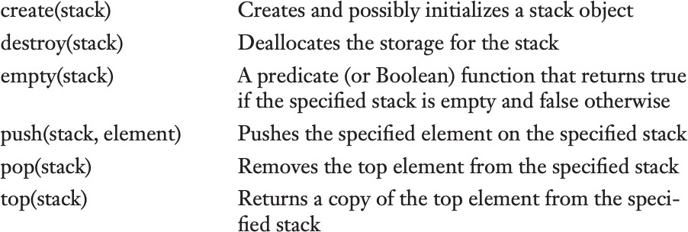
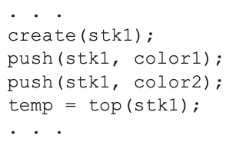
Abstraction Example
A stack is a widely applicable data structure that stores some number of data elements and only allows access to the data element at one of its ends, the top.
Suppose an abstract data type is to be constructed for a stack that has the following abstract operations:

Slide 9
Abstraction & Encapsulation - Exercises
Customer, Order, Normal Order, Special Order
Person, Student, Teacher, Address
Bank Account, Savings, Credit, Current

Slide 10
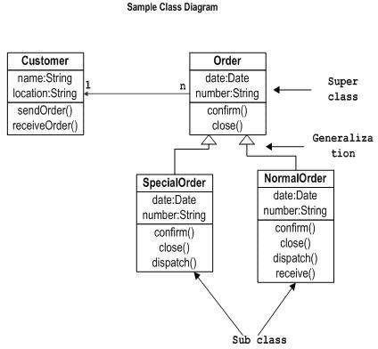
Abstraction - Answers

Slide 11
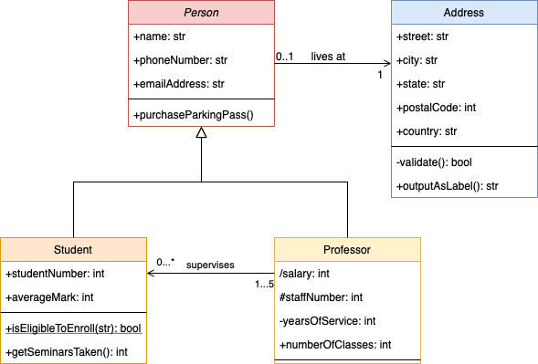
Abstraction - Answers

Slide 12
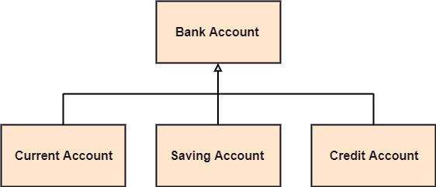
Abstraction - Answers

Slide 13
Abstract Data Types (ADT)
An Abstract Data Type (ADT) is a theoretical concept in computer science that defines a data structure purely by the operations that can be performed on it and the rules for those operations, without specifying how these operations are implemented. ADTs describe the behavior of data types from the user's perspective, but do not reveal the details of how they are implemented
Eg: Stack, Queue, List, Dictionary

Slide 14
Software Reuse and ADTs
There is constant pressure on software developers to increase their productivity.
It became apparent to many software developers that one of the most promising opportunities for increased productivity in their profession was in software reuse.
Abstract data types, with their encapsulation and access controls, are obvious candidates for reuse.
Encapsulation can also be referred to as Information Hiding.

Slide 15
Software Reuse and ADTs
The problem with the reuse of abstract data types is that, in nearly all cases, the features and capabilities of the existing type are not quite right for the new use.
The old type requires at least some minor modifications.
Modifications can be difficult, because they require the person doing the modification to understand part, if not all, of the existing code.
In many cases, the person doing the modification is not the program’s original author.
Another problem with programming with abstract data types is that the type definitions are all independent and are at the same level.

Slide 16
Software Reuse and Inheritance
Inheritance offers a solution to both the modification problem posed by abstract data type reuse and the program organisation problem.
If a new abstract data type can inherit the data and functionality of some existing type and is also allowed to modify some of those entities and add new entities, reuse is greatly facilitated without requiring changes to the reused abstract data type.
Programmers can begin with an existing abstract data type and design a modified descendant of it to fit a new problem requirement.
Inheritance provides a framework for the definition of hierarchies of related classes that can reflect the descendant relationships in the problem space.

Slide 17
Abstraction
Abstraction is one of the four fundamental principles of object-oriented programming (OOP) and involves simplifying complex systems by modeling classes based on the essential properties and behaviors relevant to the problem at hand.

Slide 18
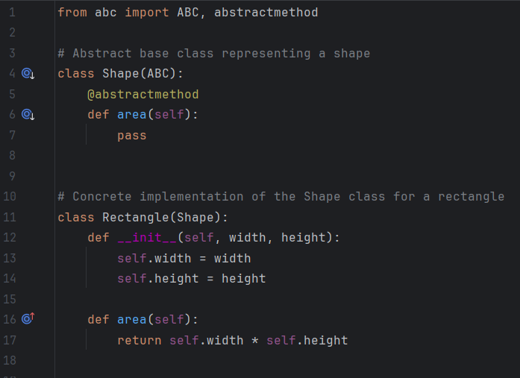
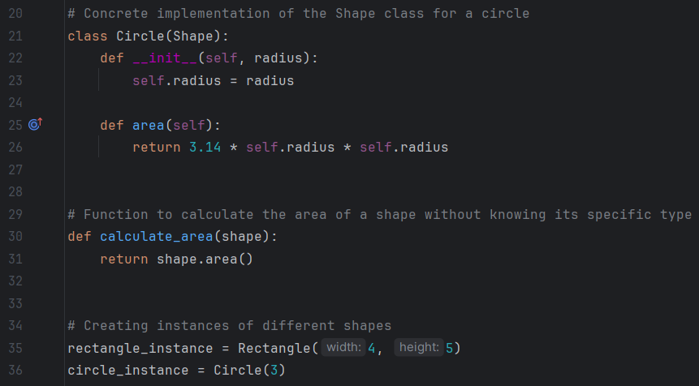
Example

Slide 19
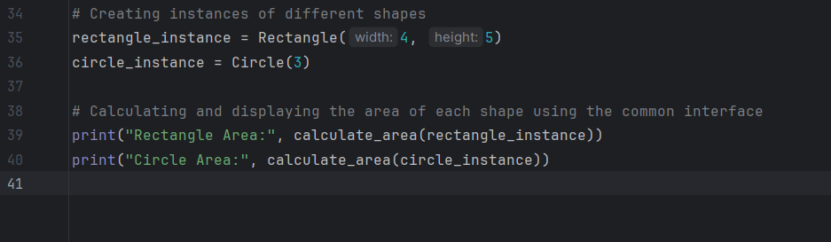

Slide 20
Abstract Classes
A blueprint for other classes might be thought of as an abstract class. You may use it to define a collection of methods that are required for all subclasses derived from the abstract class.
An abstract class is one that includes one or more abstract methods.
A method that has a declaration, but no implementation is said to be abstract.
We use an abstract class for creating huge functional units. An abstract class is used to offer a standard interface for various implementations of a component.
Notes:
Classes which are not having objects but only references, those classes are holding abstract methods, abstract method only have declaration not implementation

Slide 21
Encapsulation
Notes:
Data Hiding but manipulation is every where you go, so if you need to access any data within the class then you need to call a method belongs to the class then you can use the results that the particular method is returning
We can encapsulate and use the data through 1. use the instance of the class 2. inherit the class to inherit any of their attributes

Slide 22
Encapsulation
Encapsulation is one of the fundamental concepts in object-oriented programming (OOP). It describes the idea of wrapping data and the methods that work on data within one unit. This puts restrictions on accessing variables and methods directly and can prevent the accidental modification of data.
To prevent accidental change, an object’s variable can only be changed by an object’s method. Those types of variables are known as private variables.
A class is an example of encapsulation as it encapsulates all the data that is member functions, variables, etc. The goal of information hiding is to ensure that an object’s state is always valid by controlling access to attributes that are hidden from the outside world.
Notes:
Two ways to get the data or process of any class is u create a instance for the class or you inherit that class

Slide 23
Encapsulation
Encapsulation is one of the four fundamental principles of object-oriented programming (OOP) and involves bundling the data (attributes) and the methods (functions) that operate on the data into a single unit known as a class.
Access to the data is restricted, and it can only be accessed and modified through the methods, ensuring that the internal representation of an object is hidden from the outside world.
It refers as an object surrounding all of its properties, methods, and events into a single well-protected package. The protection comes from the object ability to hide these internal attributes and methods from outside classes.
Outside classes should not be able to manipulate internal attributes, methods, or events with a protected object.
Outside objects can make requests of an object but it is up to the internal methods of the object to determine whether the request is appropriate.

Slide 24
Encapsulation
Encapsulation is a method of wrapping data and functions into a single entity. For example, A class encapsulates all the data (methods and variables). Encapsulation means the internal representation of an object is generally hidden from outside of the object’s definition.
Using OOP in Python, we can restrict access to methods and variables. This prevents data from direct modification which is called encapsulation. In Python, we denote private attributes using underscore as the prefix i.e single _ or double __.
Need of Encapsulation
Encapsulation acts as a protective layer. We can restrict access to methods and variables from outside, and It can prevent the data from being modified by accidental or unauthorized modification. Encapsulation provides security by hiding the data from the outside world.
In Python, we do not have access modifiers directly, such as public, private, and protected. But we can achieve encapsulation by using single prefix underscore and double underscore to control access of variable and method within the Python program.

Slide 25
Consider a real-life example of encapsulation
In a company, there are different sections like the accounts section, finance section, sales section etc. The finance section handles all the financial transactions and keeps records of all the data related to finance. Similarly, the sales section handles all the sales-related activities and keeps records of all the sales. Now there may arise a situation when due to some reason an official from the finance section needs all the data about sales in a particular month. In this case, he is not allowed to directly access the data of the sales section.
He will first have to contact some other officer in the sales section and then request him to give the particular data. This is what encapsulation is. Here the data of the sales section and the employees that can manipulate them are wrapped under a single name “sales section”. Using encapsulation also hides the data. In this example, the data of the sections like sales, finance, or accounts are hidden from any other section.

Slide 26
Protected members
Protected members (in C++ and JAVA) are those members of the class that cannot be accessed outside the class but can be accessed from within the class and its subclasses.
To accomplish this in Python, just follow the convention by prefixing the name of the member by a single underscore “_”.
Although the protected variable can be accessed out of the class as well as in the derived class (modified too in derived class), it is customary(convention not a rule) to not access the protected out the class body.
Example: The __init__ method is a constructor and runs as soon as an object of a class is instantiated.

Slide 27
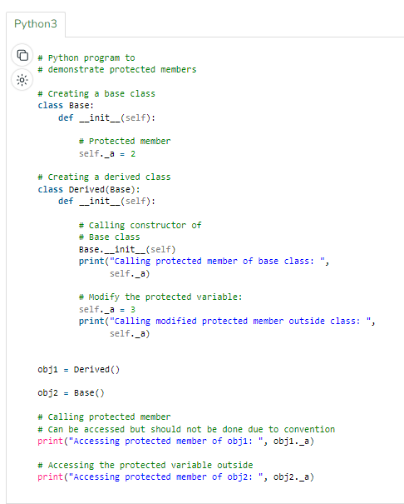

Slide 28
Private members
Private members are similar to protected members, the difference is that the class members declared private should neither be accessed outside the class nor by any base class.
In Python, there is no existence of Private instance variables that cannot be accessed except inside a class.
However, to define a private member prefix the member name with double underscore “__”.
Note: Python’s private and protected members can be accessed outside the class through python name mangling.

Slide 29
# Python program to demonstrate private members
# Creating a Base class
class Base:
def __init__(self):
self.a = "Amal"
self.__c = "Amal"
# Creating a derived class
class Derived(Base):
def __init__(self):
# Calling constructor of Base class
Base.__init__(self)
print("Calling private member of base class: ")
print(self.__c)
# Driver code
obj1 = Base()
print(obj1.a)
# Uncommenting print(obj1.c) will raise an AttributeError
# Uncommenting obj2 = Derived() will also raise an AttributeError as private member of base class is called inside derived class

Slide 30
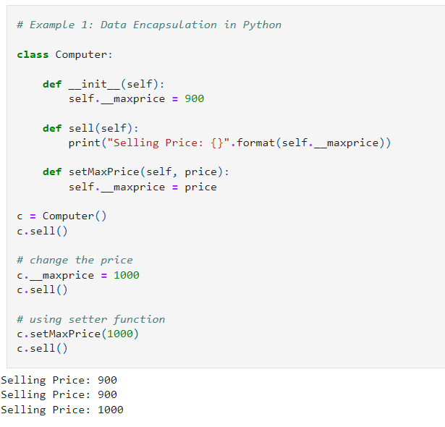

Slide 31
We used __init__() method to store the maximum selling price of Computer. We tried to modify the price. However, we can't change it because Python treats the __maxprice as private attributes.
As shown, to change the value, we have to use a setter function i.e setMaxPrice() which takes price as a parameter.

Slide 32
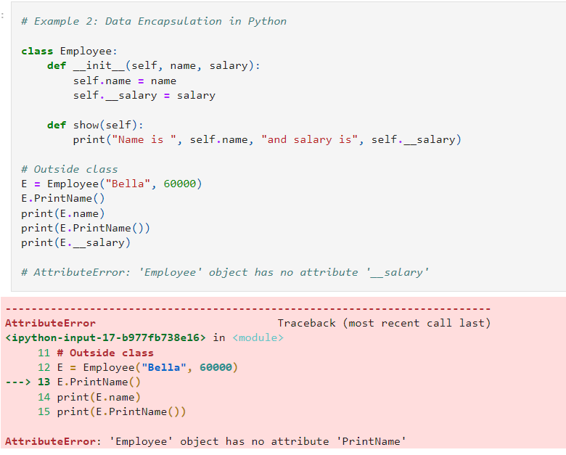
Notes:
https://blog.devgenius.io/mastering-advanced-oop-concepts-in-python-theory-behind-oop-c9e87fb1697b

Slide 33
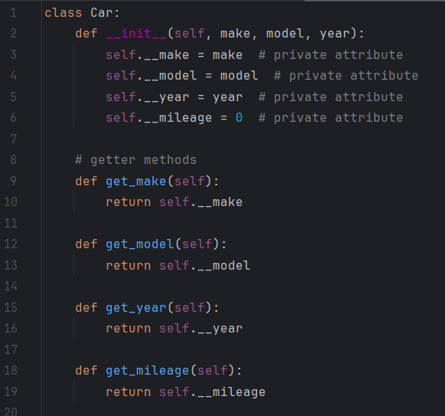
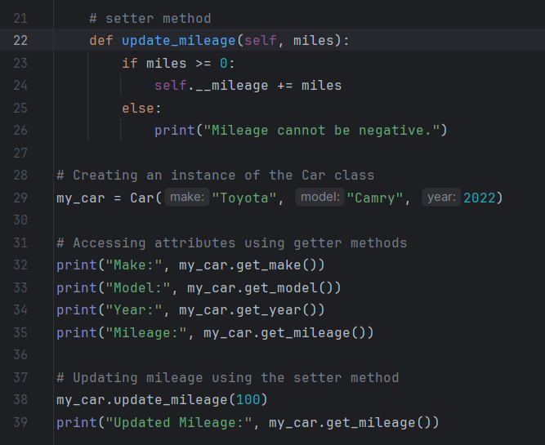
Example

Slide 34
Naming Encapsulations

Slide 35
Naming Encapsulations
There is another kind of encapsulation that is necessary for constructing large programs: naming encapsulation.
A large program is usually written by many developers, working independently.
This requires the logical units of the program to be independent, while still able to work together.
It also creates a naming problem: How can independently working developers create names for their variables, methods, and classes without accidentally using names already in use by some other programmer developing a different part of the same software system.
Notes:
Naming encapsulate is done when we declare different classes () with same name (Student class in pack1 and pack2 ) in different packages, when any third party want to use the instance from pack1 then how to call that student class belongs to pack1 – so this seperation is called naming encapsulation
In java - package
In c# - namespace

Slide 36
Naming Encapsulations
Libraries are the origin of the same kind of naming problems.
Naming encapsulations define name scopes that assist in avoiding these name conflicts with libraries.
Each library can create its own naming encapsulation to prevent its names from conflicting with the names defined in other libraries or in client code.
Each logical part of a software system can create a naming encapsulation with the same purpose.
Naming encapsulations are logical encapsulations, in the sense that they need not be physically contiguous.
Several different collections of code can be placed in the same namespace, even though they are stored in different places.

Slide 37

Naming Encapsulations - C++
C++ includes a specification, namespace, that helps programs manage the problem of global namespaces.
One can place each library in its own namespace and qualify the names in the program with the name of the namespace when the names are used outside that namespace.

Slide 38
Naming Encapsulations - Java
Java includes a naming encapsulation construct: the package.
Packages can contain more than one type definition, and the types in a package are partial friends of one another.
Partial here means that the entities defined in a type in a package that either are public or protected or have no access specifier are visible to all other types in the package.

Slide 39
Inheritance

Slide 40
Inheritance
If a new class is a subclass of a single parent class, then the derivation process is called single inheritance.
If a class has more than one parent class, the process is called multiple inheritance.
When several classes are related through single inheritance, the relationships to each other can be shown in a derivation tree.
One disadvantage of inheritance as a means of increasing the possibility of reuse is that it creates dependencies among the classes in an inheritance hierarchy. This result works against one of the advantages of abstract data types, which is that they are independent of each other.
In general, the independence of abstract data types is one of their strongest positive characteristics.
It may be difficult, if not impossible, to increase the reusability of abstract data types without creating dependencies among some of them. In many cases, the dependencies naturally mirror dependencies in the underlying problem space.

Slide 41
Inheritance
In Python, inheritance is the process of inheriting the properties of the base class (or parent class) into a derived class (or child class).
In an Object-oriented programming language, inheritance is an important aspect. Using inheritance we can reuse parent class code. Inheritance allows us to define a class that inherits all the methods and properties from parent class. The parent class or super or base class is the class which gives all the methods and properties. Child class is the class that inherits from another or parent class.
In inheritance, the child class acquires and access all the data members, properties, and functions from the parent class. Also, a child class can also provide its specific implementation to the functions of the parent class.

Slide 42
Inheritance
A class would be created that would provide an instance of variables and methods common to all of the objects in the group. This class is called a super class.
All of the objects in the group would inherit from this newly created super class. The objects in the group would be a subclass of the super class.
The super class and subclass are related in a generalization-to-specialization relationship. the super class being the generalized methods and properties while the subclass is the specialized methods and properties.

Slide 43
Types of Inheritances
Single
Multiple
Multilevel
Hierarchical
Hybrid
Notes:
There is no need to have multiple inheritance whicj cause complexity – in java we don’t have multiple inhe, only single inheritance

Slide 44
Python Inheritance Syntax
Class BaseClass:
{Body}
Class DerivedClass(BaseClass):
{Body}

Slide 45
Creating a Parent Class
# A Python program to demonstrate inheritance
class Person(object):
# Constructor
def __init__(self, name, id):
self.name = name
self.id = id
# To check if this person is an employee
def Display(self):
print(self.name, self.id)
# Driver code
emp = Person("Satyam", 102) # An Object of Person
emp.Display()

Slide 46
Creating a Child Class
class Emp(Person):
def Print(self):
print("Emp class called")
Emp_details = Emp("Mayank", 103)
# calling parent class function
Emp_details.Display()
# Calling child class function
Emp_details.Print()

Slide 47
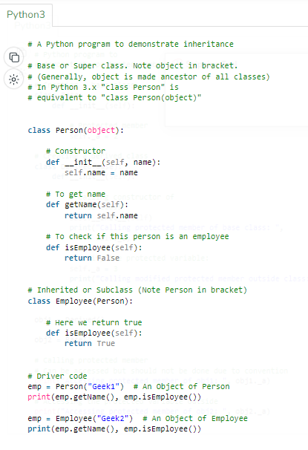
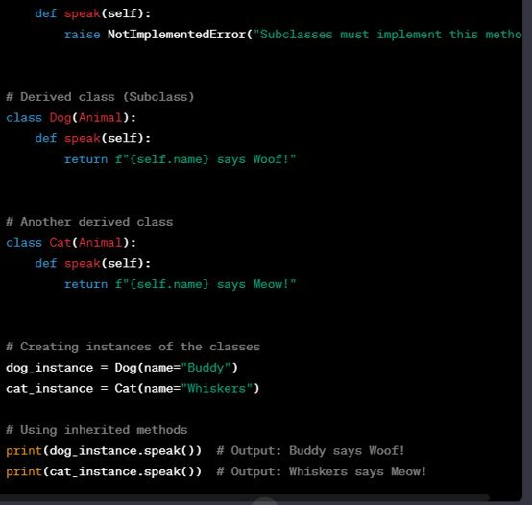

Slide 48
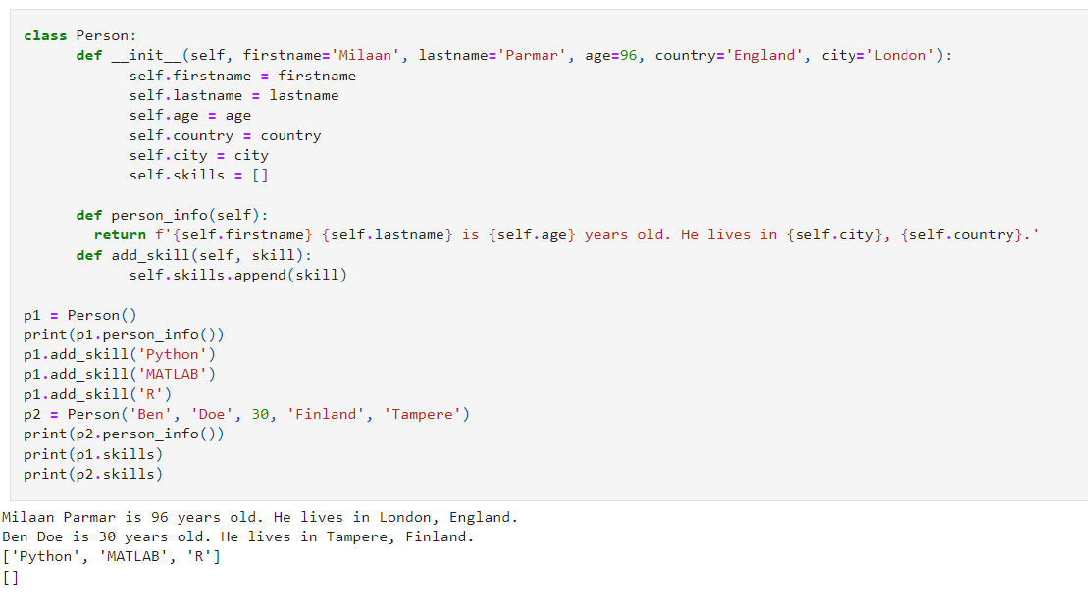

Slide 49
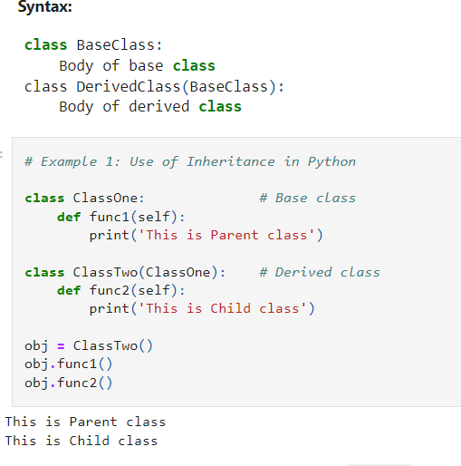
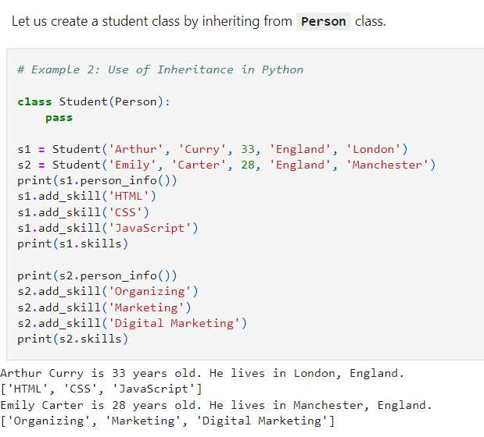

Slide 50
Explanation
We did not call the __init__() constructor in the child class. If we didn't call it then we can still access all the properties from the parent. But if we do call the constructor we can access the parent properties by calling super().
We can add a new method to the child or we can override the parent class methods by creating the same method name in the child class. When we add the __init__() function, the child class will no longer inherit the parent's __init__() function.

Slide 51
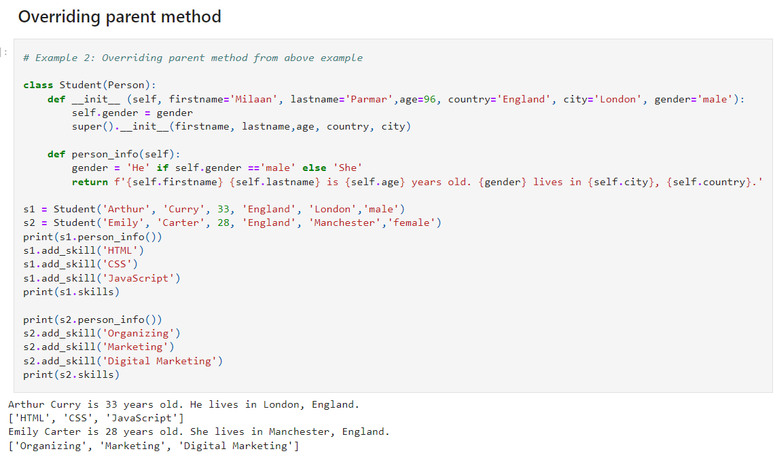

Slide 52
We can use super() built-in function or the parent name Person to automatically inherit the methods and properties from its parent. In the example above we override the parent method. The child method has a different feature, it can identify, if the gender is male or female and assign the proper pronoun(He/She).

Slide 53
Class Relationship
Composition Vs Inheritance

Slide 54
Composition
Composition is a design principle where a class is composed of one or more objects from other classes, meaning that objects of a class are used as parts or components to build another class. This creates a "has-a" relationship.
When there is a "has-a" relationship between classes. For example, a Car has an Engine.
When you want more flexibility and loose coupling between classes.
When you want to delegate tasks to other objects instead of inheriting from a superclass

Slide 55
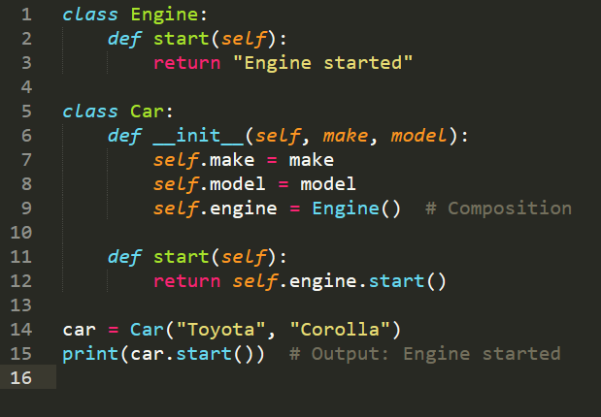

Slide 56
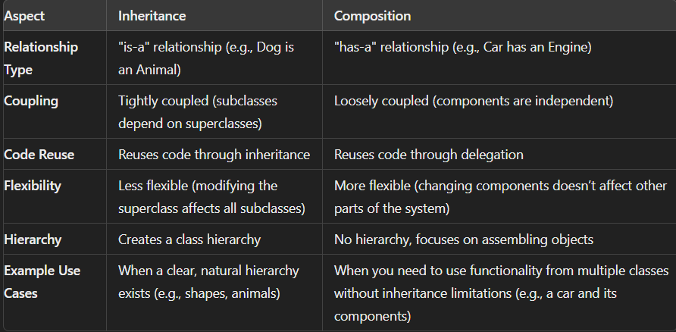

Slide 57
Polymorphism

Slide 58
Polymorphism
Polymorphism is one of the four fundamental principles of object-oriented programming (OOP) and refers to the ability of objects to take on multiple forms. In OOP, polymorphism is often achieved through method overriding and interface implementation.
Polymorphism is the ability of an object of various types to respond to method call of the same name and act appropriately. The programmer does not have to know in advance what kind of object will be used for a given method, the behavior will be determined by a runtime. This allows the programmer to simply implement a message- passing to object of various types using a common interface of operations. In Python, polymorphism allows us to define the child class methods with the same name as defined in the parent class.
Notes:
Person p1 = new Person() --- special fucntion called constructer

Slide 59
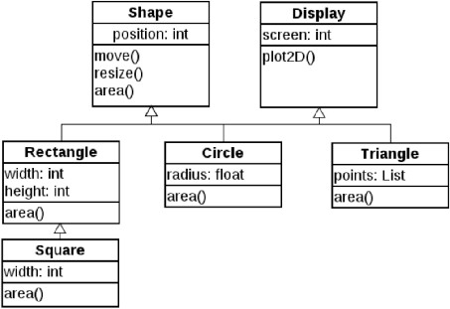
Polymorphism - Dynamic Binding
Polymorphism is provided by the dynamic binding of messages to method definitions. This is sometimes called dynamic dispatch.
Notes:
Super type can refer the subtype
Rectangle r1= new Square()
Sqaure s3 = new Sqaure()
S3.area()
Shape s1= new Rectangle()
Shape s2 = new Sqaure()
S1.area()
S2.area()

Slide 60
Super type can refer the subtype
Rectangle r1= new Square()
Sqaure s3 = new Sqaure()
S3.area()
Shape s1= new Rectangle()
Shape s2 = new Sqaure()
S1.area()
S2.area()

Slide 61
Polymorphism - Dynamic Binding
Polymorphism is a natural part of any object- oriented language that is statically typed.
Polymorphism makes a statically typed language a little bit dynamically typed, where the little bit is in some bindings of method calls to methods.
The type of a polymorphic variable is indeed dynamic.
One purpose of dynamic binding is to allow software systems to be more easily extended during both development and maintenance.

Slide 62
Polymorphism - Dynamic Binding
In some cases, the design of an inheritance hierarchy results in one or more classes that are so high in the hierarchy that an instantiation of them would not make sense.
Methods in some of these high-level classes may not have any reason for an actual implementation.
Such a method is often called an abstract method (pure virtual function in C++).
A class that includes at least one abstract method is called an abstract class (abstract base class in C++).
Abstract class usually cannot be instantiated, because some of its methods are declared but are not defined (they do not have bodies).
Any subclass of an abstract class that is to be instantiated must provide implementations (definitions) of all of the inherited abstract methods.

Slide 63
Polymorphism - Dynamic Binding
Building
draw( )
House
Temple
Cathedral
Apartment
draw( )
draw( )
draw( )
draw( )

Slide 64
Polymorphism is an ability (in OOP) to use a common interface for multiple forms (data types).
Example 1: The student can act as a student in college, act as a player on the ground, and as a daughter/brother in the home.
Example 2: In the programming language, the + operator, acts as a concatenation and arithmetic addition.
Example 3: If we need to color a shape, there are multiple shape options (rectangle, square, circle). However we could use the same method to color any shape.

Slide 65
Dynamic binding
Dynamic binding means that issuing a request doesn't commit you to a particular implementation until run-time. Consequently, you can write programs that expect an object with a particular interface, knowing that any object that has the correct interface will accept the request.
Moreover, dynamic binding lets you substitute objects that have identical interfaces for each other at run-time. This substitutability is known as polymorphism, and it's a key concept in object-oriented systems. It lets a client object make few assumptions about other objects beyond supporting a particular interface.
Polymorphism simplifies the definitions of clients, decouples objects from each other, and lets them vary their relationships to each other at run-time.

Slide 66
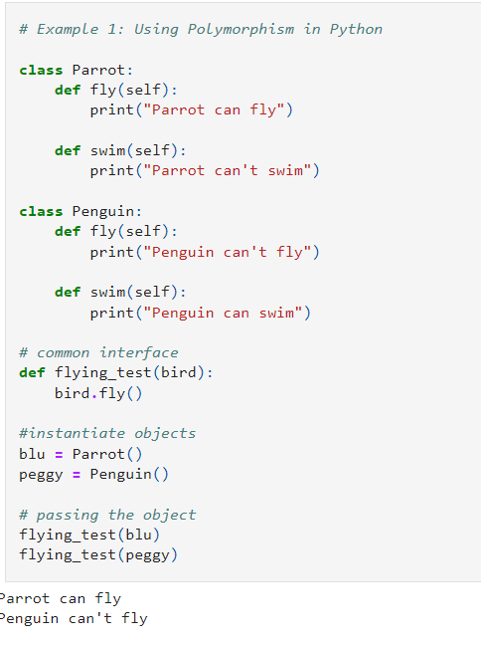
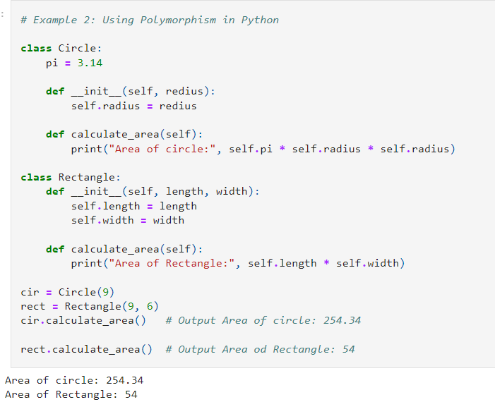

Slide 67
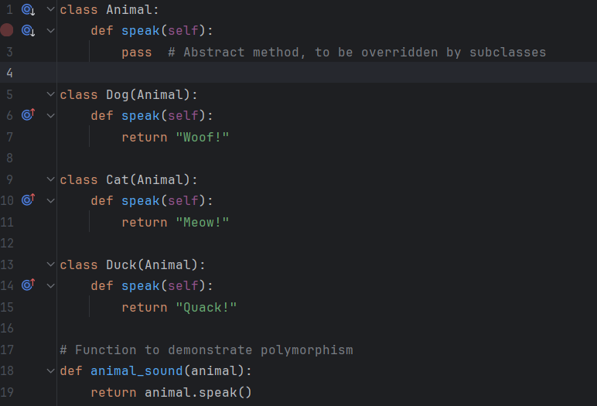
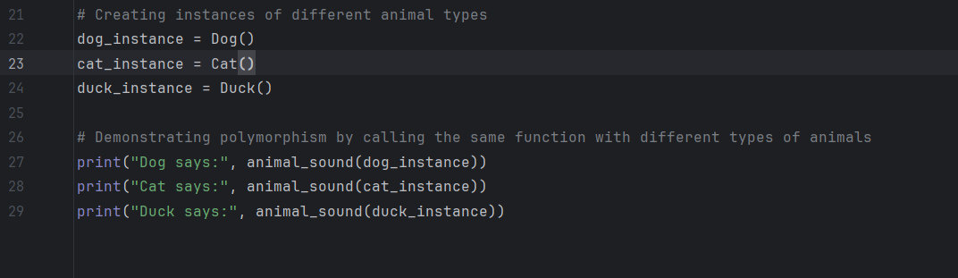
Example

Slide 68
Interface
The interface in object-oriented languages like Python is a set of method signatures that the implementing class is expected to provide.
Writing ordered code and achieving abstraction are both possible through interface implementation.
Every operation declared by an object specifies the operation's name, the objects it takes as parameters, and the operation's return value. This is known as the operation's signature. The set of all signatures defined by an object's operations is called the interface to the object. An object's interface characterizes the complete set of requests that can be sent to the object. Any request that matches a signature in the object's interface may be sent to the object.

Slide 69
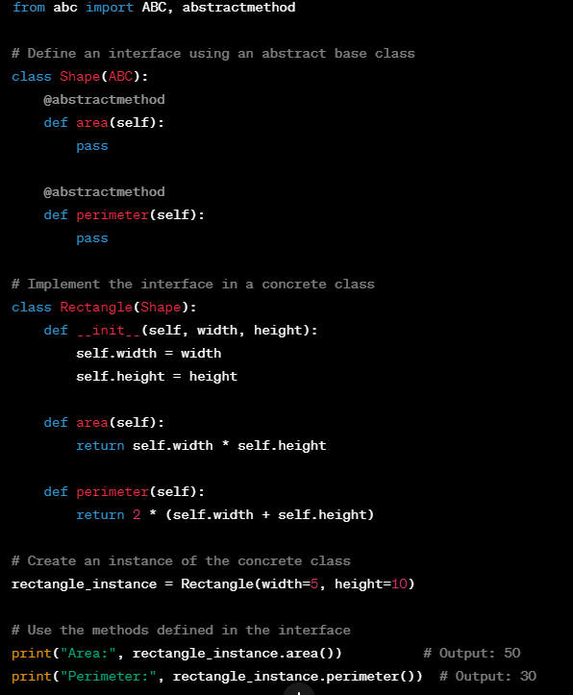

Slide 70
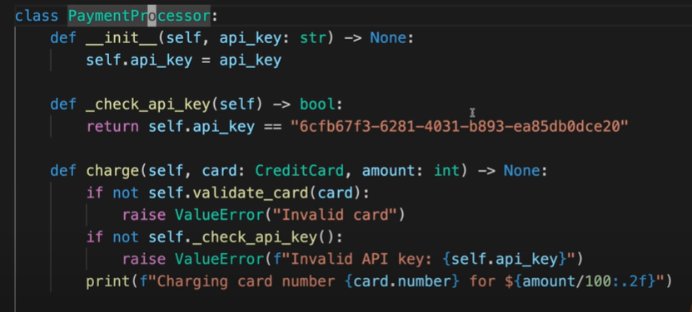
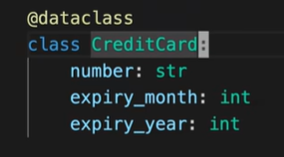
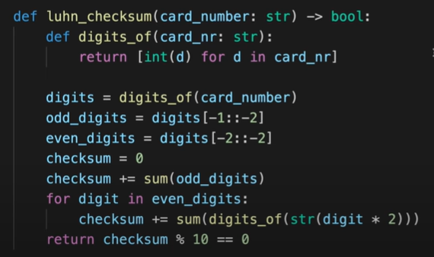
Behavior Oriented or Data Oriented

Slide 71
Method overriding and Redefinition,
In object-oriented programming (OOP), method overriding and method redefinition refer to the ability of a subclass to provide a specific implementation for a method that is already defined in its superclass.
Both concepts are essential in achieving polymorphism and facilitating code reuse

Slide 72
Method overriding
Method overriding occurs when a subclass provides a specific implementation for a method that is already defined in its superclass.
The overridden method in the subclass must have the same signature (name, return type, and parameters) as the method in the superclass

Slide 73
Redefinition
Method redefinition is a broader term that encompasses both method overriding and where a subclass redefines a method that is not present in its superclass.
It includes situations where a subclass introduces a new method with the same name as a method in the superclass

Slide 74
Templates
Templates help in reducing code redundancy and increase type safety, making them an essential tool in modern software development, particularly in systems programming, game development, and real-time applications.
The concept of "templates" is crucial in the context of generic programming, especially as implemented in languages like C++ and somewhat similarly with "generics" in languages like Java and C#.
Templates enable classes and functions to operate with generic types, allowing code to be more flexible and reusable without losing the benefits of type safety.

Slide 75
Containers
In the context of object-oriented programming (OOP), "containers" refer to data structures or objects designed to store, organize, and manage collections of other objects or primitive types.
These containers are important for handling various types of data efficiently and effectively in software applications.
They can encapsulate different data structures such as arrays, linked lists, trees, hash tables, and more, providing a high level of abstraction over the complexities of these data structures.

